Slide 1
Does Rent Control Reduce Supply on the Housing Market?
The Effect of the 1981 Austrian Tenancy Law Reform on Vacancies
Alexander Guggenberger
Notes:
Story how I lowered my rent after moving to Vienna
<Foliennummer>

Slide 2
Introduction and Motivation
Rent control is very prevalent: Housing is a basic need without substitutes!
Rent control – an economic abomination?
Price ceiling in neoclassical economics:
if market works → fewer transactions (rental price ceiling reduces supply)
If market prices too high → ceiling can increase transactions (by increasing demand)
Does a rental price ceiling reduce the supply of already existing dwelling units?

Slide 3
Methodology
Difference-in-Differences Approach using Austrian Data:
Treatment: new tenancy law, MRG 1981, higher regulation of market
Treatment group: old buildings built before 1945, rental price ceiling
Control group: new buildings built after 1945, free market prices
Hypotheses:
Primary: After the policy break, relative vacancy rate old buildings should increase compared to new buildings
Secondary: This effect should be strongest for owners who act profit maximizing (→ private persons, especially single natural persons) as compare to public owners (state, municipality) who cannot use their dwellings themselves (no opportunity costs)

Slide 4
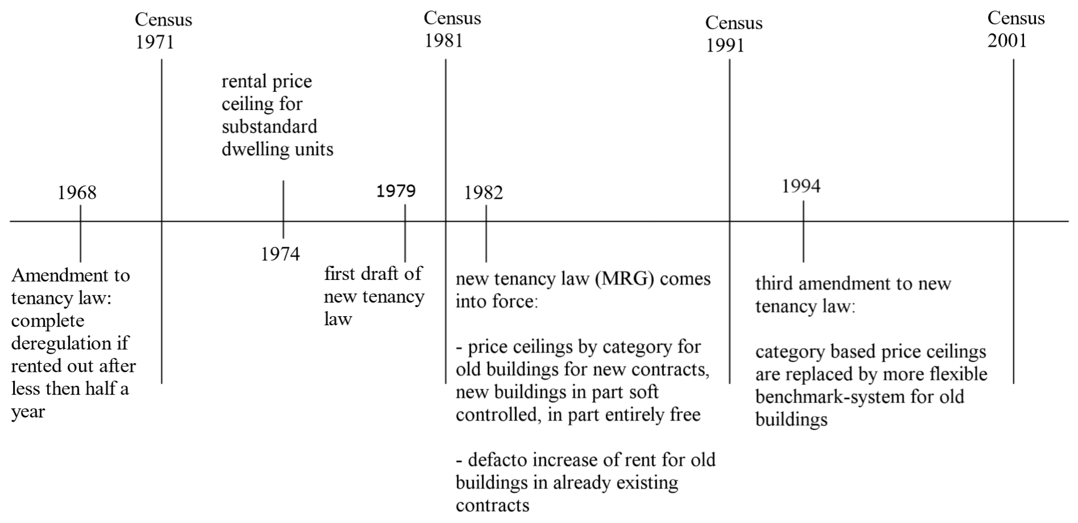
A Quick History of Austrian Tenancy Law

Slide 5
The 1982 Policy Break
Before:
only price ceiling for sub-standard flats (5% of new, 12.6% of old buildings in 1981)
After:
„Category rental price system“
For old buildings built before 1945 (exceptions see below)
Separate price ceilings depending on quality of the apartment (categories A to D)
Market price (not regulated or „adequate price“)
New buildings built after 1945
Old buildings if rented out within 6 months and:
Category A and > 90 m^2, B and > 130 m^2 (3.5% of old buildings in 1981)
Category A, B or C, if substantially renovated (no data)

Slide 6
Data
„Buildings and Dwellings Census“ (Gebäude- und Wohnungszählungen)
1971, 1981, 1991 and 2001
Aggregated by owner type/construction year interval/district - combinations for all four years
Dependent Variable: Number of units that are not registered as main residences
These units could be supplied to the market (assumption)
Controls: numbers in each category, user of dwelling
Additional demographic variables from the simultaneous censuses (Volkszählungen)
On district level
Numbers per age groups, educational attainment etc.
Bad control problem?

Slide 7
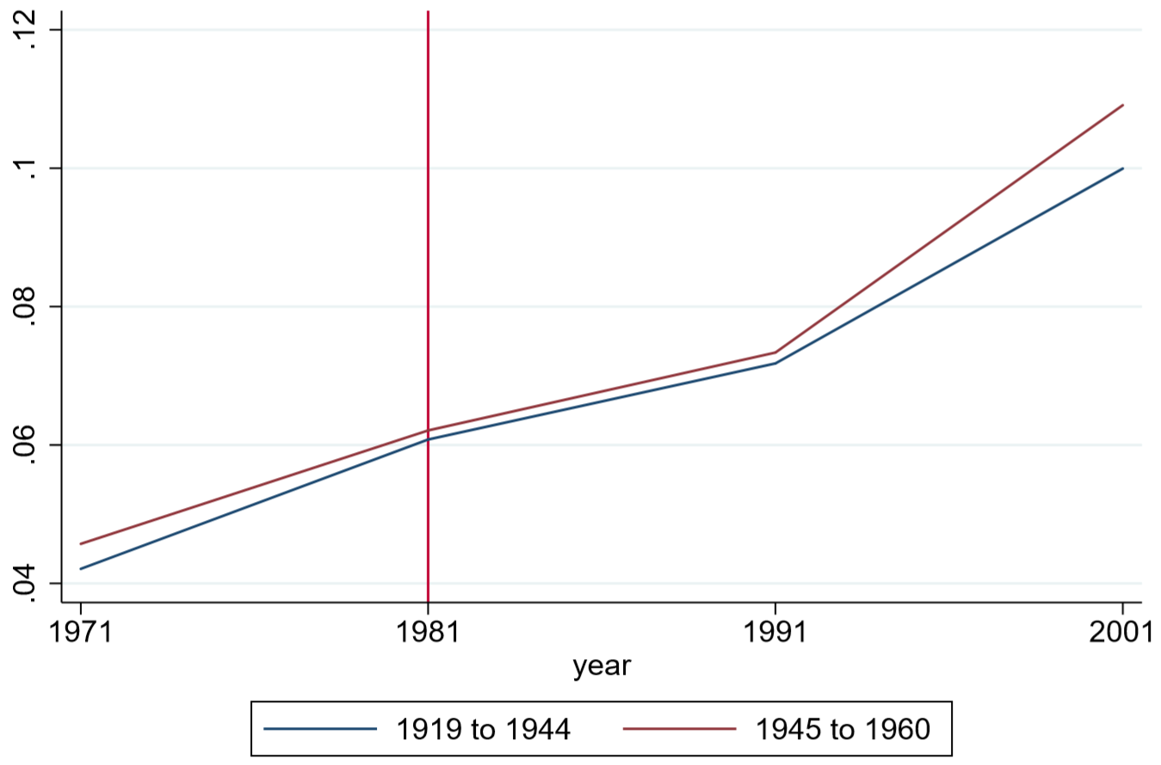
The Development of Vacancy Rates

Slide 8
Model
Frequency-weighted logistic regression
vac_{i,t} = β₀ + β₁time_{t} × old_{i} + β₂time_{t}+ β₃old_{i} + β₄GWZ_{i,t} + β₅VZ_{i,t} + β₆year_{t} + β₇group_{i} + ε_{i,t} [weights, clusters]
Coefficient of time_{t} × old_{i} is the treatment effect
GWZ_{i,t} are controls from the buildings and dwellings census in %
VZ_{i,t} are controls from the normal census in %
Year_{t} and group_{i} are year and group fixed effects

Slide 9
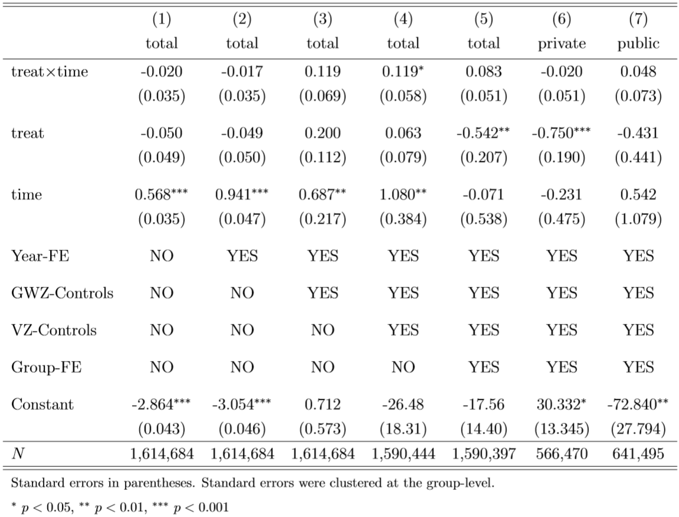
Results I

Slide 10
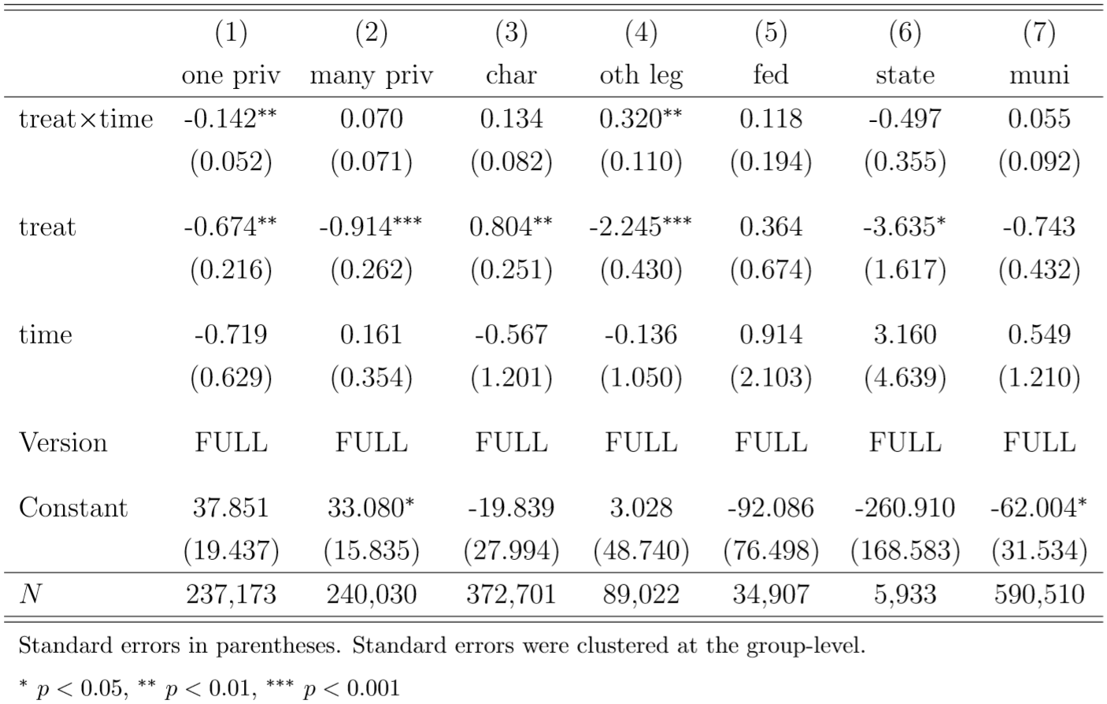
Results II – by owner type

Slide 11
Conclusion
No reliable evidence for the expected adverse effect of rent control on the supply on the housing market
No actual effect (market did not work as it should anyway)
Non-main residence is bad proxy for vacancy, tons of other reasons for having secondary residences
Non-parallel trends of groups, too much is happening in the housing market that drives vacancy rates other than tenancy law
Groups are not perfectly stable (possible to escape regulation by renovating and merging flats, systematic selection)
Systematic changes in numbers in groups (dwellings taken down, merged, separated)

